Slide 1
Greg Focaccio - Audience Attention
[Picture of: Transmission Line, Comm Link/ Network Map, AI]
Besides Electrical Power, what does a modern weapon system need to be useful?
Hint: It’s part of NIWC’s Name
<Answer1>
Is <Answer1> useful if is it stays in one place or is confined to one system?
No.
So, how does <Answer1> get around?
<Answer2>
That, <Answer2>, is what I do.
I design and make ways for <Answer1> to get around using <Answer2>.
Note: This is only becoming increasingly important.
What is coming next?
Intelligence. Intelligence also need to move around, so <Answer 2> is becoming even more informant for this reason.

Slide 2
Greg Focaccio - New Employee Brief
Greg Focaccio
Code xxxxx
Date
IT Specialist

Slide 3
Greg Focaccio – Personal Info
Hobbies
Building and learning new network and system design
Gardening Native Plants
Hiking
Tennis
Interests
Technology
Nature - Desert / Mountains / Beach
Fun Facts
I was born soon after the successful Apollo 11 Moon launch
I’ve been to Egypt, drunk from the Nile, and been to the King’s Chamber in the Great Pyramid (1991)
I participated in 2 Rock N’ Roll Marathons (2007, 2010)
I’ve summited San Jacinto (10,834 ft) near Palm Springs and am working towards Mt Whitney in the next year or two
My first computer was an IBM PC with two floppy drives and no graphics, but it had BASIC.

Slide 4
Greg Focaccio - Personal Info
Family History
Father’s side: From Naples, in US since 1880 – Great Grandfather Raffael Focaccio via Ellis Island to Jersey City
Mom’s side: French Canadian, in US since late 1800s, Settled in Somerset, Wisconsin (Very small farming town)
Me: Native San Diegan
Father came to San Diego to visit his Sister, a Navy Nurse, then decided to move here (196?)
Mom followed a school friend to San Diego in the early 1960s
Where I live
Tierrasanta (Near Miramar Air Station)
Married to Karen for 16 years
3 Children: 12 Raffaela, 9 Dalton, 4 Isabella
3 Older Children (out of the house): 27 (Twins), 29
1 Twin Married to Army (rank)
1 Twin Airforce Active Duty GIS in Beal AFB, CA
Pets
Desert Tortoise
Small Dog – Toy Poodle mix

Slide 5
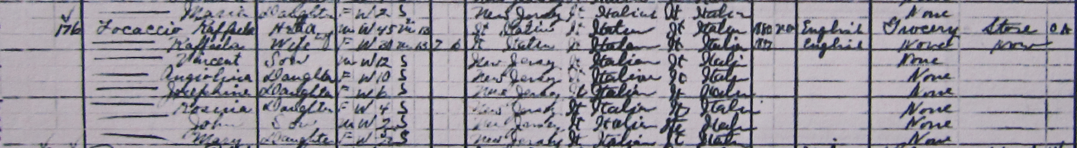
Greg Focaccio - Personal Info
Great Grandfather in US Census 1910 – Jersey City, New Jersey
Maternal Grandmother with Chicken Coop – Somerset, Wisconsin

Slide 6

Greg Focaccio - Personal Info
Family in Alaska
July 2025

Slide 7
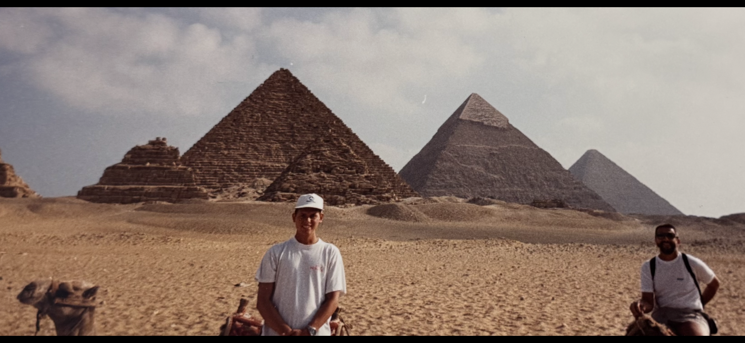

Greg Focaccio - Personal Info
Egypt with Dad
1991
Marathons
2007 & 2010

Slide 8
Greg Focaccio - Professional Background
Education
Pomona College, BA Biology, Cum Laude 1991
Medical School (Incomplete) 1992-1995
Adult School / Cisco Network Academy Southwestern College
Certifications
Cisco Certified Network Professional (Last 202X)
Security Plus (Current)
Work Experience
15+ Years experience across the full spectrum of Networking work
Network Design and Engineering – Create Solutions, develop and test configurations
Network Implementation and Infrastructure - Racking, Cabling, Turn-Ups, Migrations
Network Operations - Monitoring, Management, Troubleshooting
Positions
1 Year – Principal Network Engineer – SD Datacenter ISP (M5 Hosting)
2 Years – (DoD) SIPR Transport NMCI (Perspecta) <2018-2020>
2 Year – Principal Network Engineer – SD Datacenter ISP (CARI.net)
3 Years – Senior Network Engineer – Network ISP and VoIP Provider (NextLevel Internet)
3 Years – Partner Network Engineer – Network Consulting Company (GoNet Forward)
4 Years – Junior Network Engineer – Network Services Company (Network Insight)

Slide 9
Greg Focaccio - NIWC PAC
4th Year at NIWC PAC
4th Year as Network Engineer with same Branch / Project
Since Summer 2021
2nd Year as Navy Civilian
Since Spring 2023
My Role
Network : <Photo of Aladin network Genie – w my face
Network Design (Creation of Solutions)
Network Engineering (Configuration)
Network Implementation (Racking, Cabling, Configuring)
Network Operations (Monitoring, Management, Troubleshooting)
What Differentiates me:
Perspective and Gratitude – Appreciation for the earned prestige of the Center and being able to contribute to as a member of the Nission is a primary motivater, not just a job
Age and Continuity – Plan to remain with NIWC and NAVWAR is a differentiator versus younger staff desiring build broader careers
Drive for
Background rooted in
Sincerity
Team player
Accept Difficult work

Slide 10
Greg Focaccio - NIWC PAC – Project Accomplishments
Fleet
Supported project during major milestone
System accepted as modernized replacement for past system within X
Engineered Cybersecurity improvement to satisfy cutover requirement
Supported initial site Cybersecurity improvement implementation at X
Brought first network visibility capability to system
Supported key external system assessments
Support for external agency assessments
Test Facility (Pac X Lab)
Modernized management of lab network components
Added unified console access
Added lab capabilities
Added new wide area network (WAN) simulator
Added Tools and network modeling system to lab network
Configured International network link to UK for key capability PA Demo

Slide 11
Greg Focaccio - NIWC PAC – Project Goals
Short and Mid Term
Fleet
Finish System Network Hardware Modernization
Finish follow-up Cybersecurity hardening
Improve Cyber Integrations and Automated patching
Support new key integrations and Demos
Lab
Continue conforming lab infrastructure as Fleet representative
Develop configuration automation and Testing automation
Long Term
Fleet
Network IP Architecture
New Virtualized Environment
Redesign WAN connectivity architecture
Add Mature Monitoring and Management systems
Configuration Automation
New Cybersecurity Capabilities and Design
2 Factor Identity and Access Management

Slide 12
Greg Focaccio - NIWC PAC – Personal Goals
Short and Middle Term
Continue on Project as key Network technical performer
Mentor and train new network team member
Branch out to support other High Profile Projects
Learn more about Managerial Skills
Learn about RF, develop IP over RF network designs
Learn about Non-terrestrial network
Bring capabilities to from systems
Longer Term
Learn and begin training in Technical Team Management
Learn more about Acquisition Processes
Support NIWC PAC and NAVWAR Missions as technical team manager
Develop and participate in novel capability creation

Slide 13
Greg Focaccio - Project Review
Releasable or CUI for X
*What it does
*What it integrates with
*Roadmap for new capabilities
*Roadmap for new integaritions
New ST approaches

Slide 14
Greg Focaccio - Quick Bio
Who
What
Where
When
Why
How

